Slide 1

Cybersecurity |Data Science |Mobile Development/IoT | Information Technology |DevOps
SBA
U.S. Small Business Administration
8(a) Certified
Customer success and satisfaction with excellence in delivery
Technuf Technology Team
October 2021

Slide 2
OVERVIEW
Core Competence
Overview
Software Engineering (ERP, CRM, Web, DB, Interfaces etc.)
Cyber security
Quality Assurance
Program Management
Cloud Computing
AI / ML / IOT
Data, Analytics & BI
120 Employees
HQ in Washington DC Metro
Offices in Silicon Valley
Offshore development facility
Trusted partner for large enterprises
Customer Success
Advantage
IRS – App Dev, Cybersecurity
Cisco – Mission Critical App Dev
USPTO – Infrastructure, SDLC
HISD – Mobile/IoT App Dev
MWAA – IT Support Services
NIH – Data Analytics
DoD– SharePoint Development
Quality
Cost-competitive
Innovative Solutions
Highly Responsive
Customized Products
Extremely talented & committed staff & partners

Slide 3
Technuf Certifications
SBA 8(a)
GSA IT Schedule 70
MBE (Minority Business Enterprise)
SBE (Small Business Enterprise)
DBE (Disadvantaged Business Enterprise)
LDBE (Local Disadvantaged Business Enterprise)
VA SWaM (Small, Women-owned, and Minority-owned Business (SWaM)
Cisco ATP (Authorized Technology Provider)
GS PSS (Global Supplier)
ISO 9001
ISO 27001
CMMI Level 3 Certified

Slide 4
Technuf Advantages
Skilled | Scalable | Trusted
Staff competency and expertise Supports complex and high visibility projects | Proven, scalable staffing model with quality retention Client-partnership and client-advocate strategic approach | Multiple high-visibility enterprise-wide projects High customer satisfaction Account growth
People: Our pledge to our associates’ satisfaction allows for high retention rates of our highly skilled associates.
Processes: Our commitment to cost-effective solutions, transparency, and continuous knowledge sharing allows for ongoing process improvements. We are committed to CMMI and ISO 9001 standards.
Customer Satisfaction: This has been the singular most important factor contributing to our past growth.

Slide 5




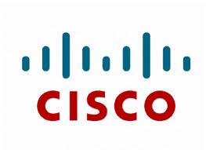





Where we work
Internal Revenue Service (IRS)
DoD (Department of Defense)
National Institute of Health (NIH/NIDDK)
U.S. Department of Commerce (DoC/USPTO)
Metropolitan Washington Airport Authority (MWAA)
Cisco Systems
Huntsville Independent School District
DC Public School
Presidio
DISYS
Davra Networks
Tait Communications
Grameen Phone
Yoga Alliance
ORA

Slide 6
Service Offerings
S/W Engineering
Big Data Analytics & BI
Program Management
Project & Program Management
O&M
Infrastructure O&M
Cloud Computing
Mobile
Social Media
Training/Mentoring
Tier 1, 2, & 3 desktop support
Virtualization and private cloud system support
Disaster recovery
Enterprise Lifecycle Management
Estimation and Budgeting
Cyber Security
VoIP/Collaboration
IoT App Dev
AI / ML
ERP, CRM, Web, DB and DI Applications
Approach
Industry best practices
Agile
CMMI
Six Sigma
Customer adopted SDLC
Continual development cycle
Distributed development
PMBOK-based best practices
Deliver on-time within budget
SLA driven
24x7 support
Multi-tier support
Best practices & standards
ITIL

Slide 7
Technuf’s Service Capabilities
Application Development
Business & Systems Analysis
Architecture, Design &
Implementation
Quality Management
Operations & Maintenance
Methodologies (SDLC, Agile, Waterfall, Best Practices)
ITIL V3
Security
Program & Project Management

Slide 8
Technology Solutions for NIDDK
Interface with unstructured data
QlikView Business Discovery platform & ETL
Denormalization, Tagging & Standardization
Data Architecture
Data Security
Data Warehousing Adapters
Data Mining
Intelligent Search Engine
Advanced Analytics
Statistical Inference
Real-time reporting & Alerts

Slide 9
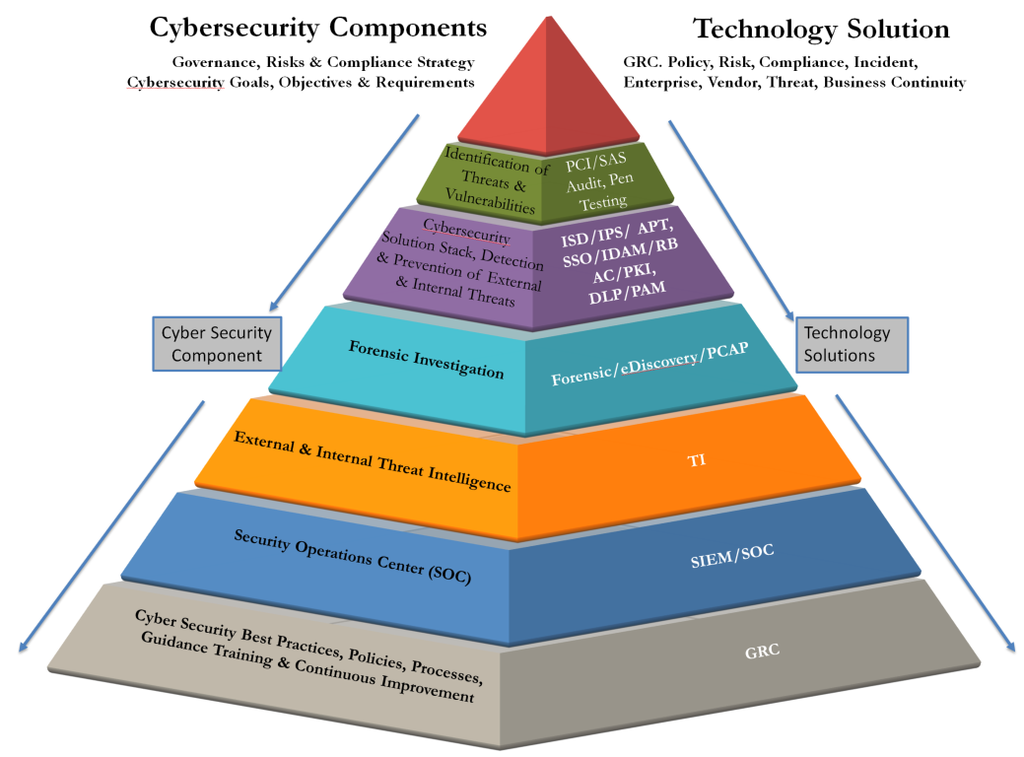
Technology Solutions Mapped to Cybersecurity Components
A cook book to checkup the health
of the cybersecurity environment for an agency
and the steps to mitigate any risks and
vulnerabilities
Case studies from the world’s largest financial
institutes (IRS) and show how we secure their IT
infrastructure
In order to protect the enterprise,
the organization must take this holistic view
that addresses the entire range of threats,
vulnerabilities and associated remediation.

Slide 10
Comprehensive Approach to Cybersecurity
Multiple Data Centers
Standards Driven

Slide 11
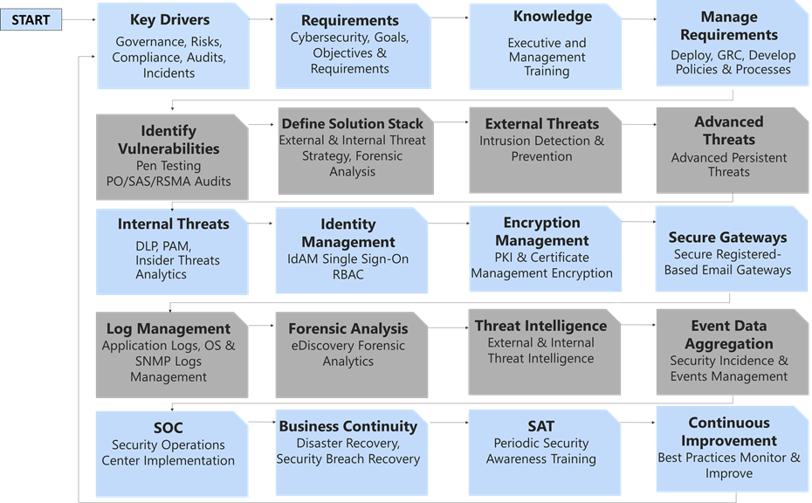
Needs-Driven Cybersecurity Solutions

Slide 12
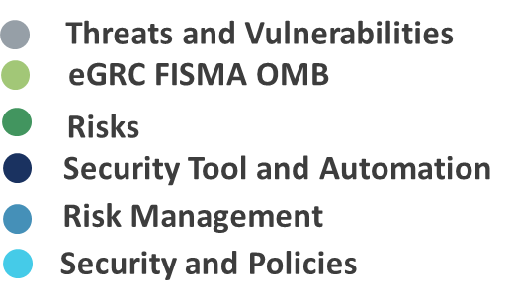
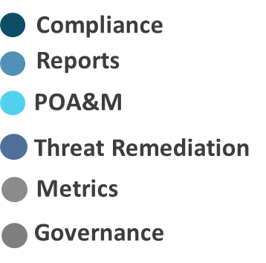
Cybersecurity risk management

Slide 13
SECURITY TRAINING
1
Presentation, Video & Workbook
Diverse Training materials for administrators and end-users.
2
Security Awareness Training
Provide cybersecurity awareness training
3
Personalized training for personnel with elevated privileges
Role Based Training
4
Specialized IT Security Training
Deliver training based on emerging technologies.
Training materials support insider threat indicators, with strategic notes on implementation and mitigation best practices.

Slide 14
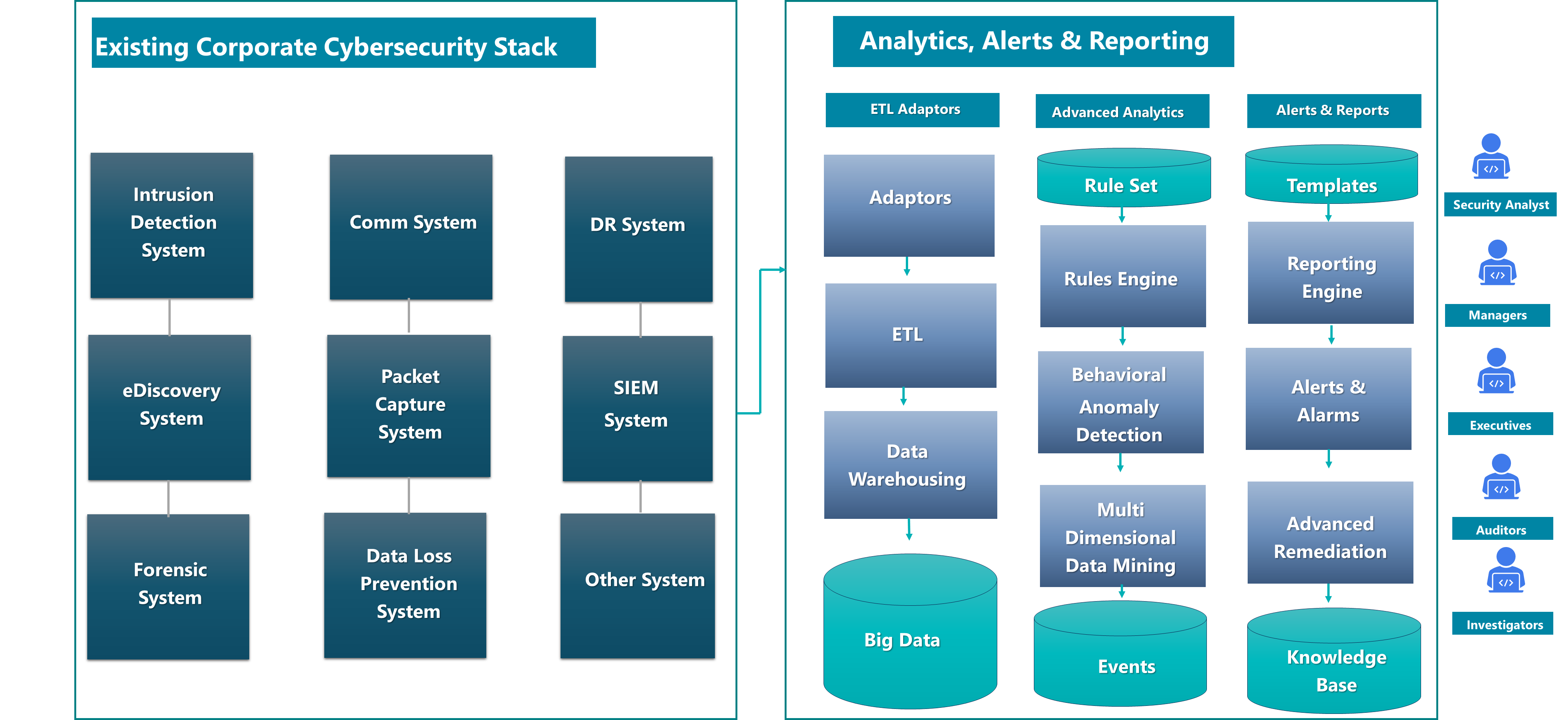
SECURITY Operations Center

Slide 15



FISMA COMPLIANCE
POAM
SAR
Audits, FISMA, OMB,
Internal, GAO
Audit Management
SAP
FISMA Compliance
SAT, SITS
Requirement
FISMA Training
Compliance
LMS
Reports
Notifications
FISMA Compliance
FISMA Security and
Configuration Management
Device Status & SCM
SCC
Security Scans
Update Devices

Slide 16
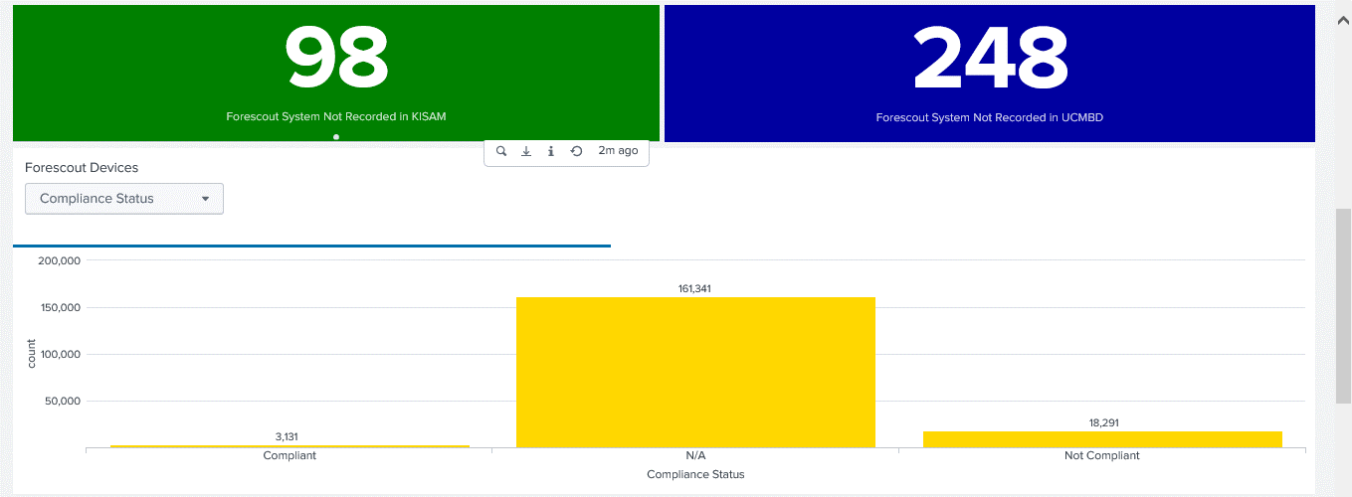
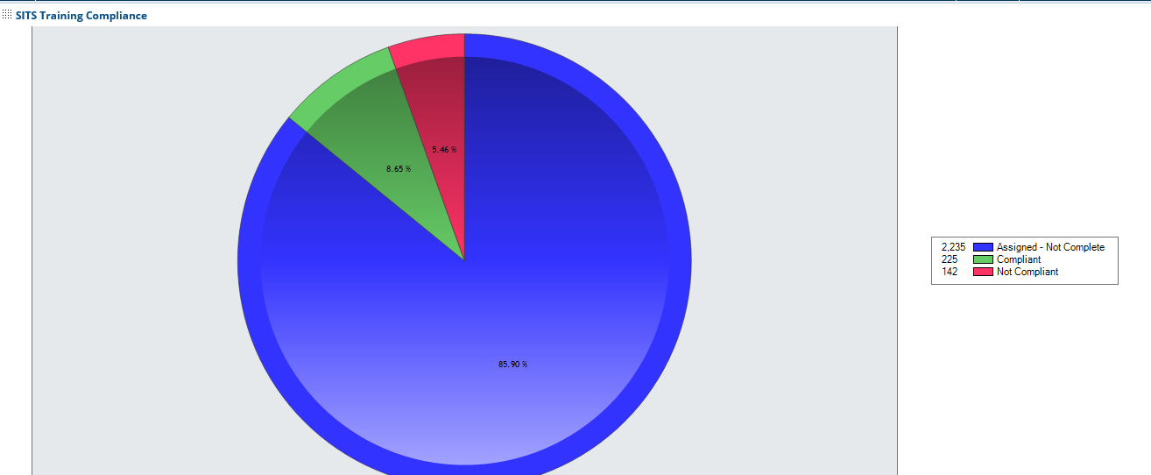
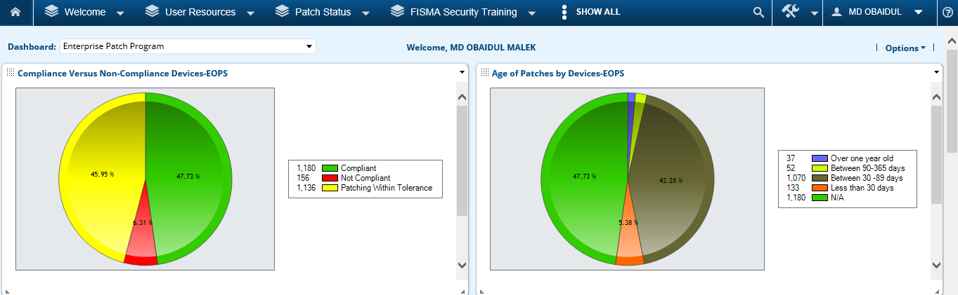
FISMA Reporting and Dashboards - Examples
Device Compliance
Security Awareness Training Compliance
Patch Status

Slide 17
Comprehensive Cybersecurity Support to our Customers
Intrusion Detection (IDS)
Intrusion Prevention (IPS)
Penetration Testing
Vulnerability Assessment
Security Operations Center (SOC)
Governance and Compliance
Security Audit - PCI, SAS, NIST
Forensic Analysis and eDiscovery
Data Loss Prevention (DLP)
Privileged Access Management (PAM)
Authentication/Authorization
Single Sign-on (SSO)
Role Based Access Control (RBAC)
Identity and Access Management (IdAM)
Deep Packet Capture
Insider Threat Detection/Prevention
Advanced Persistent Threat (APT)
Cyber Threat Intelligence (CTI)
Secure communications
Certification & Accreditation
Risk Assessment & Security Planning
Cybersecurity Training

Slide 18






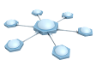



Software delivery is at the heart of today’s top technology trends
Big Data Insights on new products by more efficiently interpreting massive quantities of data
Cloud
Demand for apps requires fast, scalable environments for dev and test, as well as production
Social Business
Broader set of stakeholders collaborates to deliver continuous innovation and value
Instrumented Products Industry requirements demand faster response to regulations
and standards, with traceability and quality
Software delivery
Mobile Modern workforce expects constantly updated software to connect to enterprise systems
Intelligent/ Connected Systems Software component in smart products driving increased value and differentiation

Slide 19




DevSecOps Model
Continuous Business Planning
Accelerate software delivery
faster time to value
Plan & Measure
Enterprise capability for continuous software delivery that enables clients to seize market opportunities and reduce time to customer feedback
Continuous Monitoring
Collaborative Development
Continuous innovation, feedback and improvements
Balance speed, cost, quality and risk
increased capacity to innovate
Monitor & Optimize
Develop & Test
Continuous Customer Feedback and Optimization
Release & Deploy
Continuous Testing
Reduce time to customer feedback
improved customer experience
Continuous Release and Deployment

Slide 20
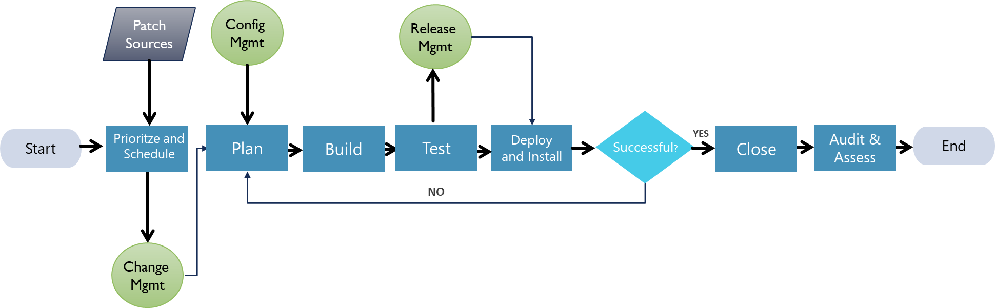
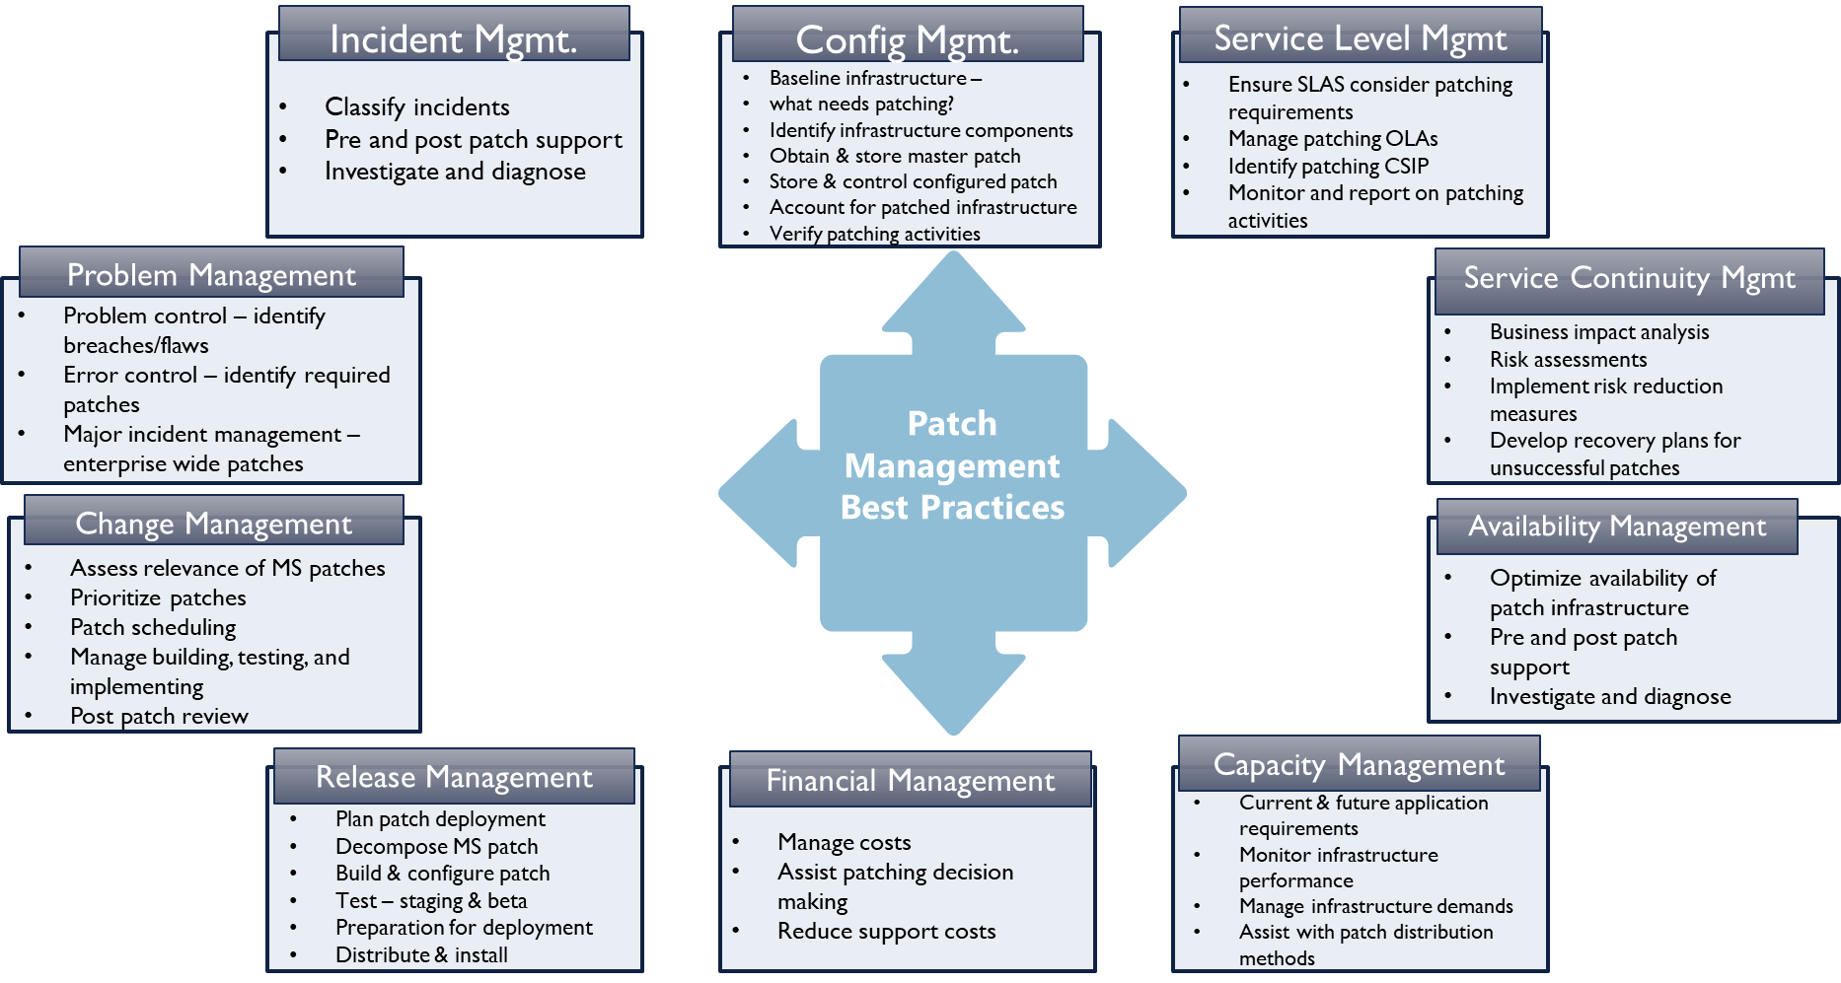
Typical patch management process
In accordance with NIST 800-34 Standards

Slide 21
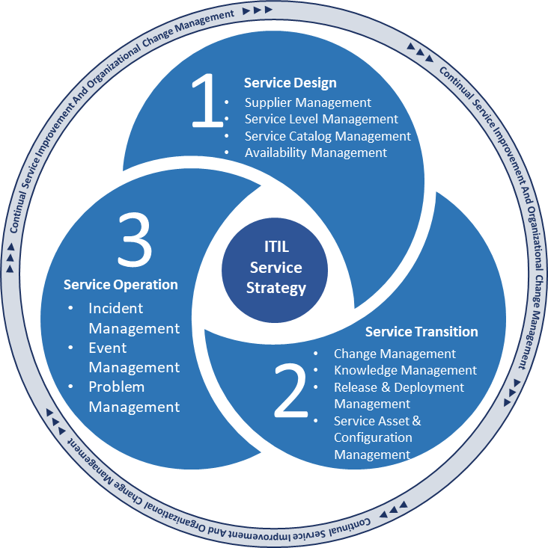
ITIL BASED O&M
Assessment and Formulation of Overall Cybersecurity Strategy
Security Architecture Solution
Security Audits
Compliance
Governance
Penetration Testing
Customer Requirements
Tools, technologies & cybersecurity solutions
Policies, Processes, procedures and guidelines
Development of training
Execute the Solution
Preparing the Organization for solution
Monitor
Assess
Mitigate
Deploy solutions
Training

Slide 22
Cloud Migration Experience
Application and Data Migration to the Azure/AWS cloud
PCI/PII data masking
Voltage Encryption (AES 256 FPE)
Optimize Cloud scaling
Significant Cost savings
Mainframe Modernization Experience
CI/CD approach
Provide Hybrid Cloud Solutions
Setup Custom DevOps catalogs
Automated Testing tools
Thorough topology review process for future proofing solutions
Moved over 100TB of data from On Prem to Cloud Storage
EBCDIC to ASCII conversion
AWS/Azure Cloud solution – Cost/In-house tools
Application porting without rewrite
Application containerizing (Docker, Kubernetes,ACS)
NSG/Firewall rules for On-Prem to Cloud communication
Traffic management for most efficient routing
Iaas/PaaS solutions
Import/Export experience to lower bandwidth consumption
Training sessions
No SQL DB solutions (MongoDB, Document DB)

Slide 23
Share Point Development at DoD
HQ’s SharePoint portal
Supports 15 workflow applications
Has an audience of 1200 users
35 SharePoint site pages
4 active Software development projects
Develop, Administer & Maintain SharePoint Applications & Web Apps
Administer Learning Management Systems (LMS) functions
SharePoint technology stack (i.e. the layers of software and services that comprise SharePoint)
SharePoint custom application development and methodology
Web Software Development
Web Design for User Experience (UX)
LMS Administration
US Department of Defense Information System security requirements

Slide 24
Three Tier SharePoint Technology Stack

Slide 25
SharePoint Architecture

Slide 26
Application Development
Industry best practices
Agile
CMMI
Six Sigma
Customer adopted SDLC
Continual development cycle
Distributed development
Technuf’s Approach
Business and requirements analysis
Architecture management
Detailed design, implementation, and integration
Safety critical applications
Real-time solutions
Fault-redundant systems
Mission critical applications
Business Intelligence
Safety critical applications for emergency responders
Enterprise applications across 140K user base
Social multi-media applications across targeted to several million end users
Enterprise data warehouse with advanced analytics and reporting
Expertise Delivered
Objectives Met

Slide 27

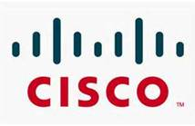
Testing Strategy
Secure Communications Performance Testing
DLP Functionality, Usability and Accessibility (508) Testing
PCAP Customer Acceptance Testing
EnCase Forensic Analysis Functionality Testing
Integration & Regression Testing
Performance Testing
UAT
Notes:
Make sure the bullets are lined.

Slide 28
Product Offerings
Safety Critical Applications
Cisco’s IPICS (IP Interoperability Collaboration System)
Mission Critical Applications
Aphelia Collaboration System
Educational Applications
Tutor Toolbox
First Responders
Army Training System
Utility, Oil & Gas
Student Management
Lesson Management
Assessment & Progress
Instructor Management
Air Force Radio Integration
Transportation – School Bus Connect
Real time Surveys and Dashboard
Physical Security
Online & Collaborative Learning, Literacy
Solves
Collaboration amongst disparate groups
Manage emergency incidence and simulation exercises
Unified dispatching
Intelligent personnel allocation
Real-time multi-media and voice communication
Real-time management reporting
K12 bus riders’ safety
Comprehensive education lifecycle support
Rapid enablement in literacy
Improving life skills

Slide 29
Technuf Advantages
Quality
Highly skilled staff
Cost-Competitive
Flexible cost structure and labor categories
Responsive
Committed to customer success
Innovative
Adapt to Enterprise customers and environments
Exceeding customer expectations and needs
Range of licensing models to adapt to small to enterprise customers
24 X 7 support
Creative products and solutions

Slide 30


Slide 31
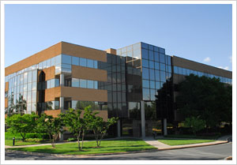
Contact Information
Corporate Headquarters: 40 W Gude Dr., Suite 220 Rockville, MD 20850 Phone: (301) 526-7888
Fax: (202) 627-3002
Website: www.technuf.com
General Info: info@technuf.com

Slide 32
Thank you

Slide 33
Backup Slides

Slide 34



Application Development
Complex, real-time incident response system
Multi-tier architecture with mobile clients
Globally distributed development teams
Enterprise deployment
Asset library
Document workflow management
Training & coaching of Agile process
Flexible framework for deploying social multi-media based applications
Game engine
Data collectors
Customizable data analytics
Reporting

Slide 35
Cybersecurity
Comprehensive approach
Compliance to government & industry standards
Technuf’s Approach
Forensic analysis and eDiscovery
Data Loss Prevention
Identity and Access Management
Authentication/Authorization
RBAC
Deep packet capture
Intrusion Detection
Governance and compliance
Secure communications
Information Assurance
Certification & Accreditation
Virtualization
Protect corporate assets & sensitive data (PII)
Data in Motion
Data at Rest
Data in Use
Strengthen corporate’s ability to defend against legal actions
Expertise Delivered
Objectives Met

Slide 36
Quality Management
Continuous validation
End-to-end traceability
On-demand impact analysis
Coverage analysis
Maximize automation
Defect management & trend analysis
Technuf’s Approach
Functionality Testing
Performance Testing
Usability and Accessibility (508) Testing
Customer Acceptance Testing
Integration & Regression Testing
Manual & automated testing
Multiple dimension of quality
Increase quality metrics
Optimized testing value
Expertise Delivered
Objectives Met

Slide 37
Operations & Maintenance
SLA driven
24x7 support
Multi-tier support
Best practices & standards
ITIL
Technuf’s Approach
Infrastructure O&M
System performance monitoring and optimization
Asset management
Tier 1, 2, & 3 desktop support
Security administration
Incident management
Disaster recovery
Virtualization and private cloud system support
DBA support
Core load software deployment
Upgrade/patch management
High customer satisfaction
Optimized operational processes
Increased efficiency & availability
Reduced manpower & cost
Expertise Delivered
Objectives Met

Slide 38
Program and Project Management
Leverage best practices
Focused on relationship
Deliver on-time within budget
Technuf’s Approach
SDLC management
PMBOK-based best practices
Requirements management
Resource management
Communications
Risk management
Change management
Training
Asset management
Scheduling
Budget and status monitoring and reporting
Increased Efficiency
Improved quality of delivery
Met time & budget constraints
Trusted advisors
Supported annual budget planning
Expertise Delivered
Objectives Met
Notes:
Requirements management
Resource management
Communications
Risk management
Change management
Training
Asset management
Scheduling
Budget and status monitoring and reporting

Slide 39
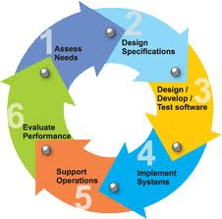



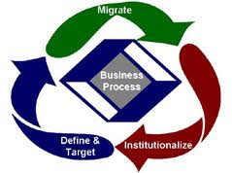
Program and Project Management
Practices | Achievements
SDLC | Agile as part of the standards CMMI
Risk Management | Upfront risk loading Manageable iterative deliverables
Cost Optimization | Automation Globally diverse teams
Transparency | Reporting Dashboards
Process Optimization | Streamlined Target-driven

Slide 40
Summary
Documented Results…
Risk Control
Transparency
Cost Savings
Customer Satisfaction
Quality Delivery
Process Improvements
Delivered Through...
Constant Communication and Management Accessibility
Direct stream of communication
Proactive identification of issues and risks
Highly Qualified Professionals
Performance-based compensation
Continuous skill development
Customer-centric training
High retention rate

